Slide 1
Philippines 2012

Slide 2
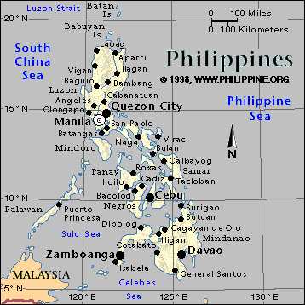
Philippines 2012

Slide 3
Philippines 2012

Slide 4
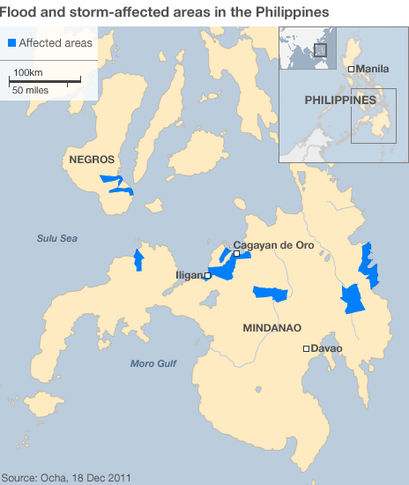
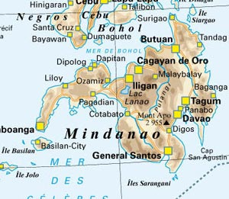
Philippines 2012
Mindanao:
Cagayan De Oro
Iligan

Slide 5
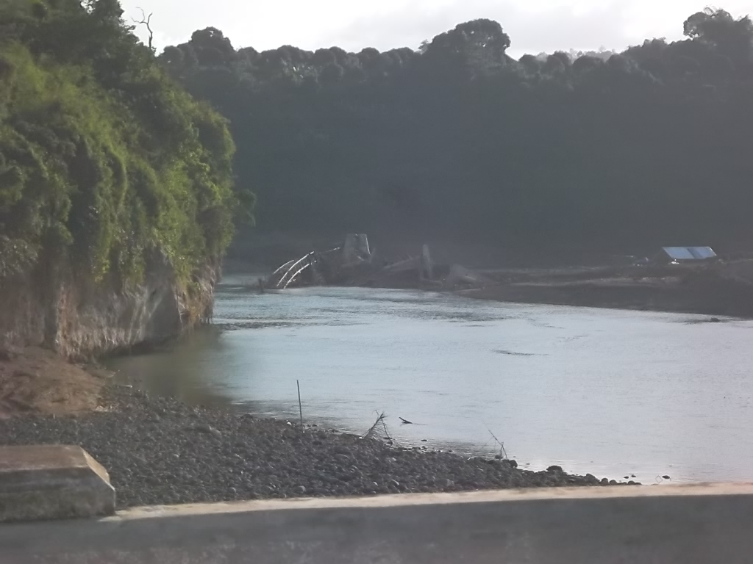
Philippines 2012

Slide 6
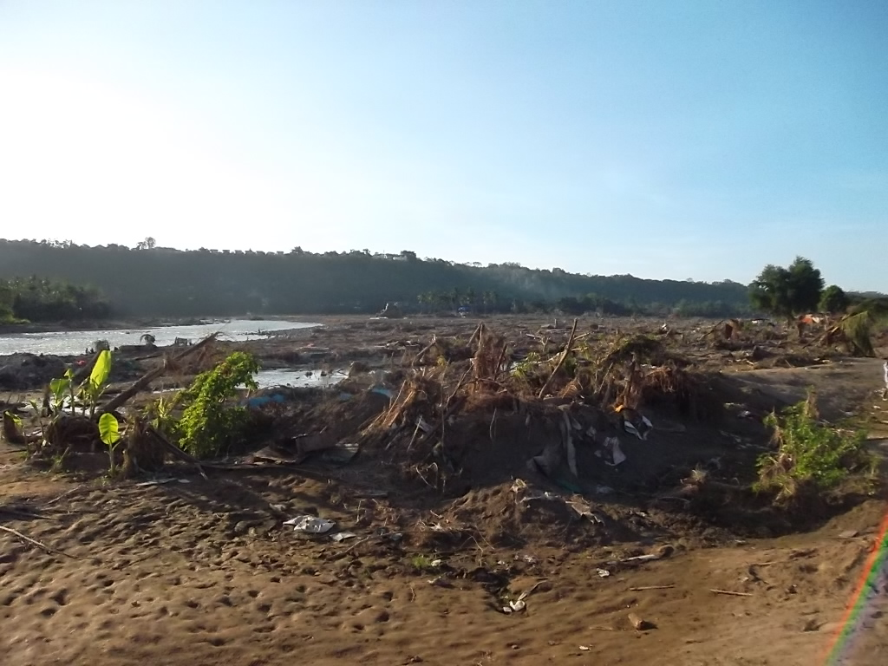
Philippines 2012

Slide 7
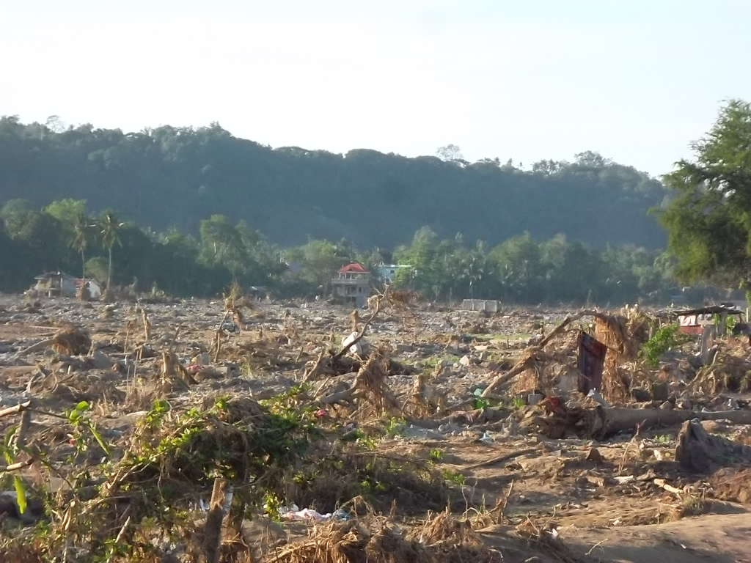
Philippines 2012

Slide 8
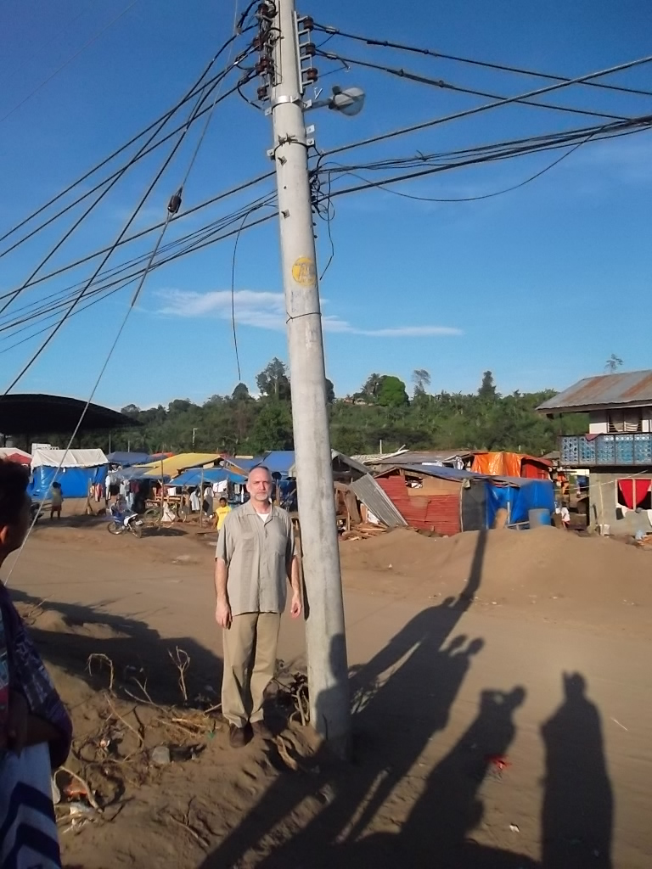
Philippines 2012

Slide 9
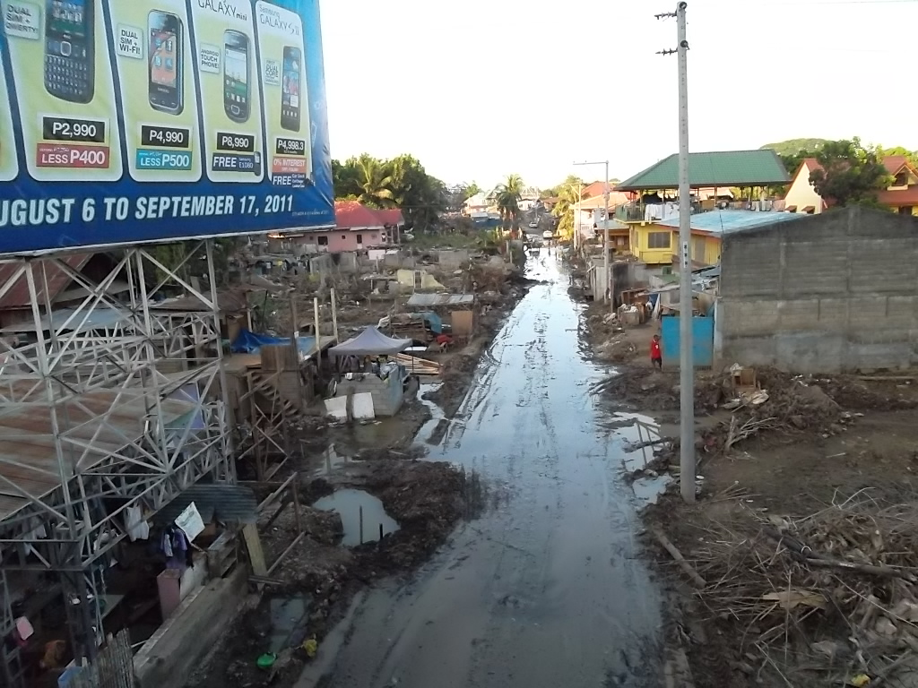
Philippines 2012

Slide 10
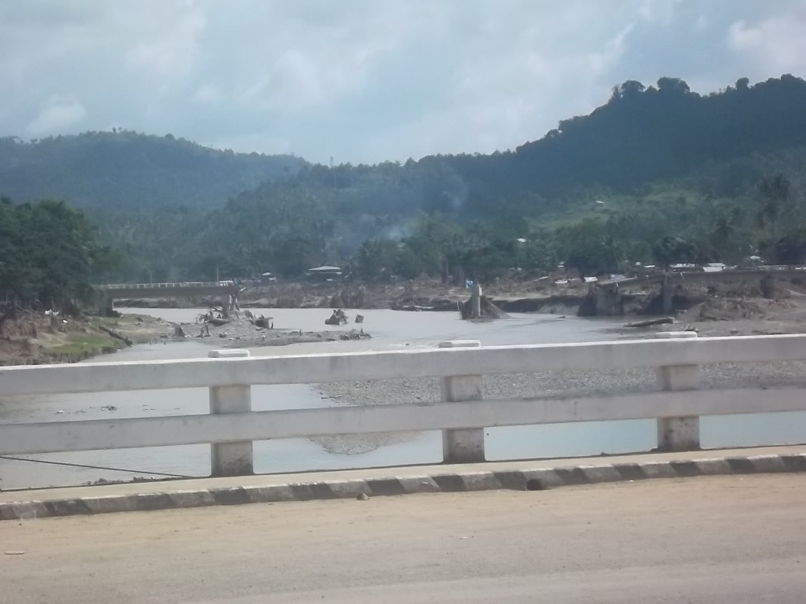
Philippines 2012

Slide 11
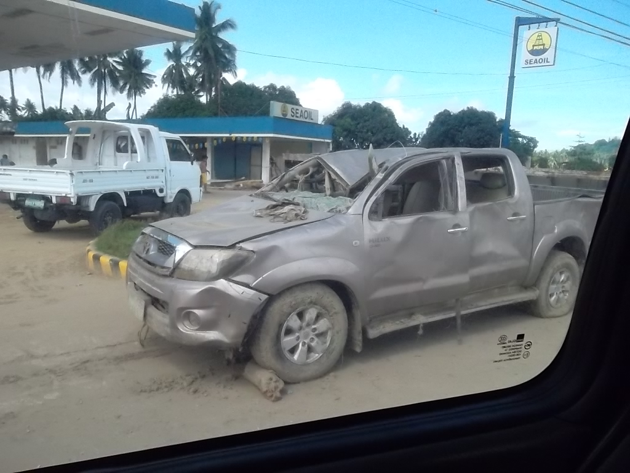
Philippines 2012

Slide 12
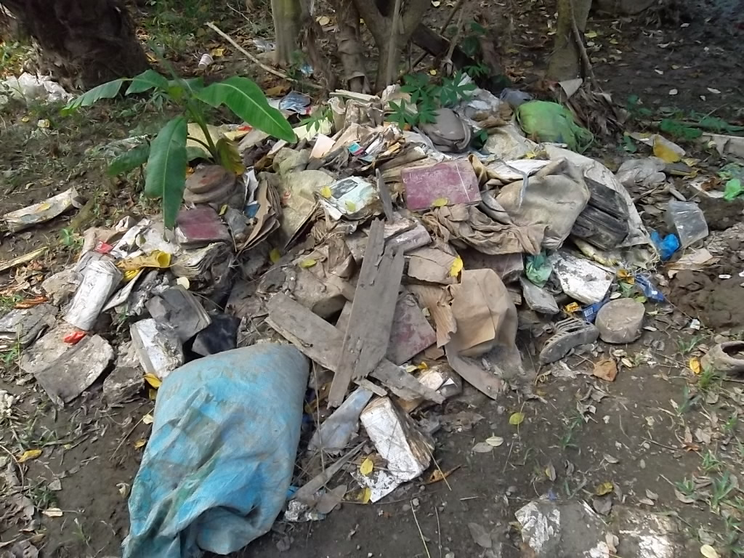
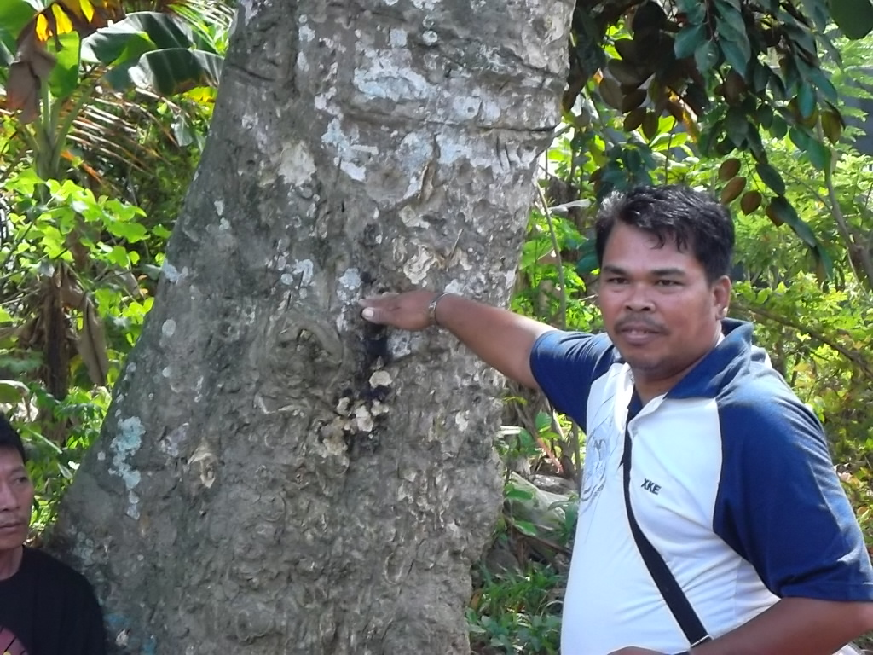
Philippines 2012
Santiago church of Christ – Iligan
Edgar Samodal

Slide 13
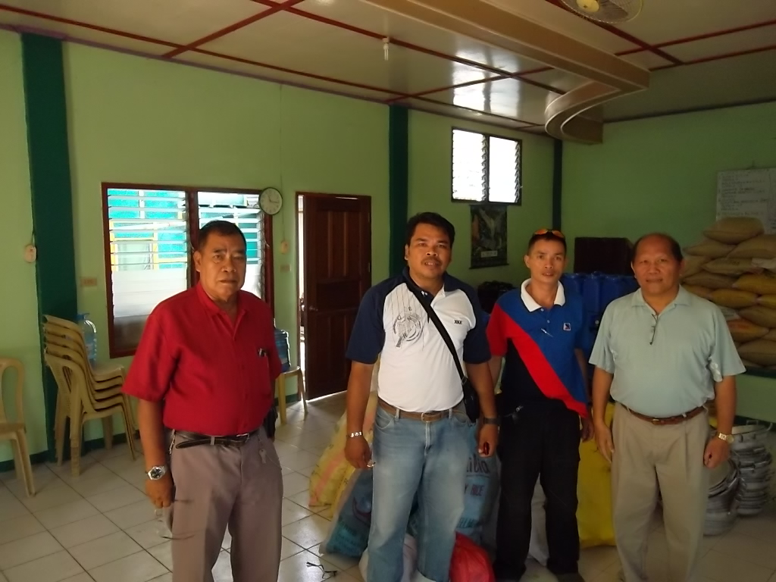
Philippines 2012
Fred Samodal,
Edgar Samodal,
Cipriano Carpentero Junior, Jonathan Carino

Slide 14
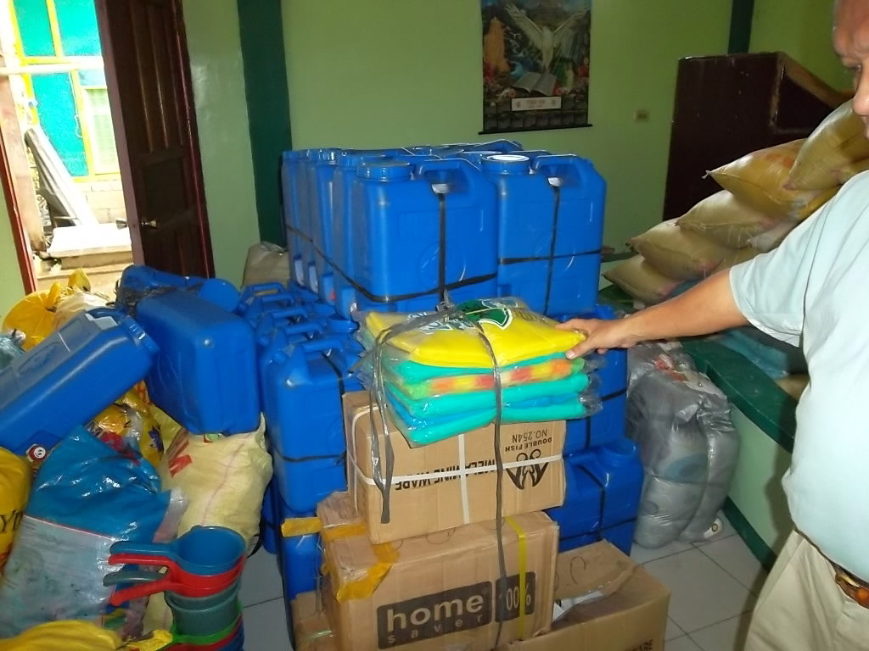
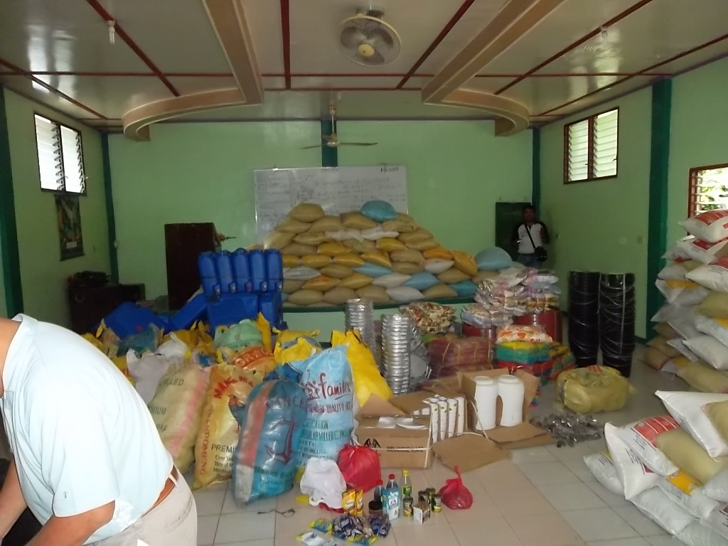
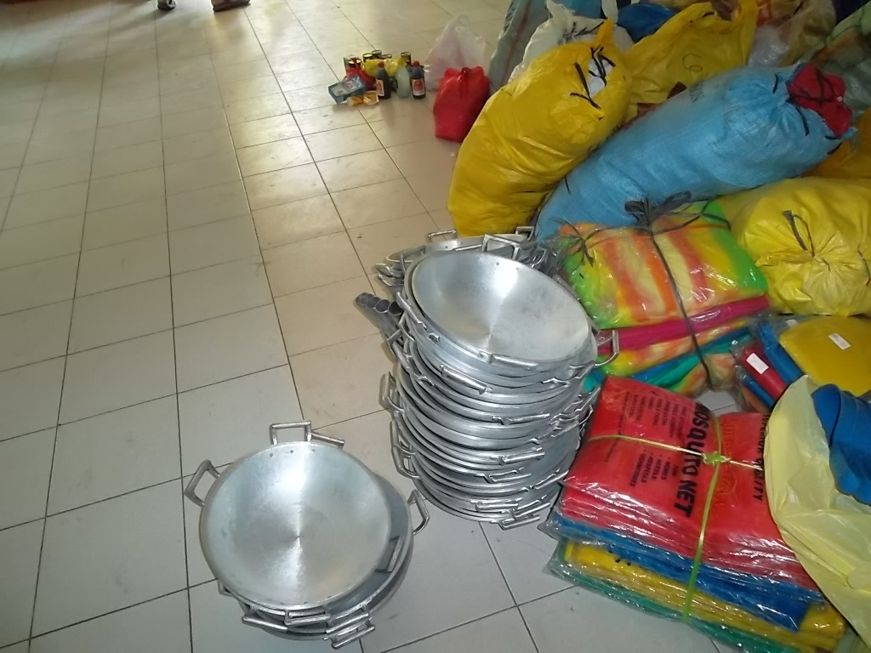
Philippines 2012

Slide 15
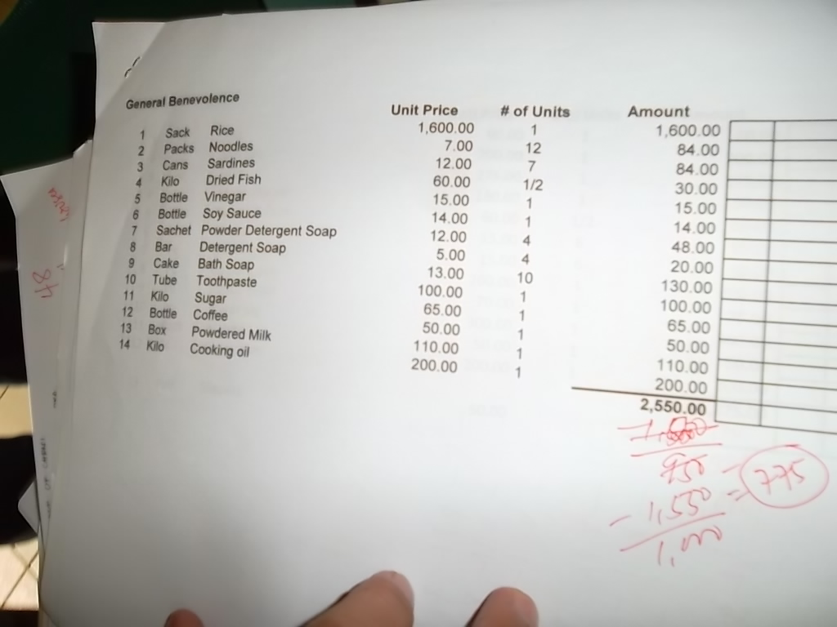
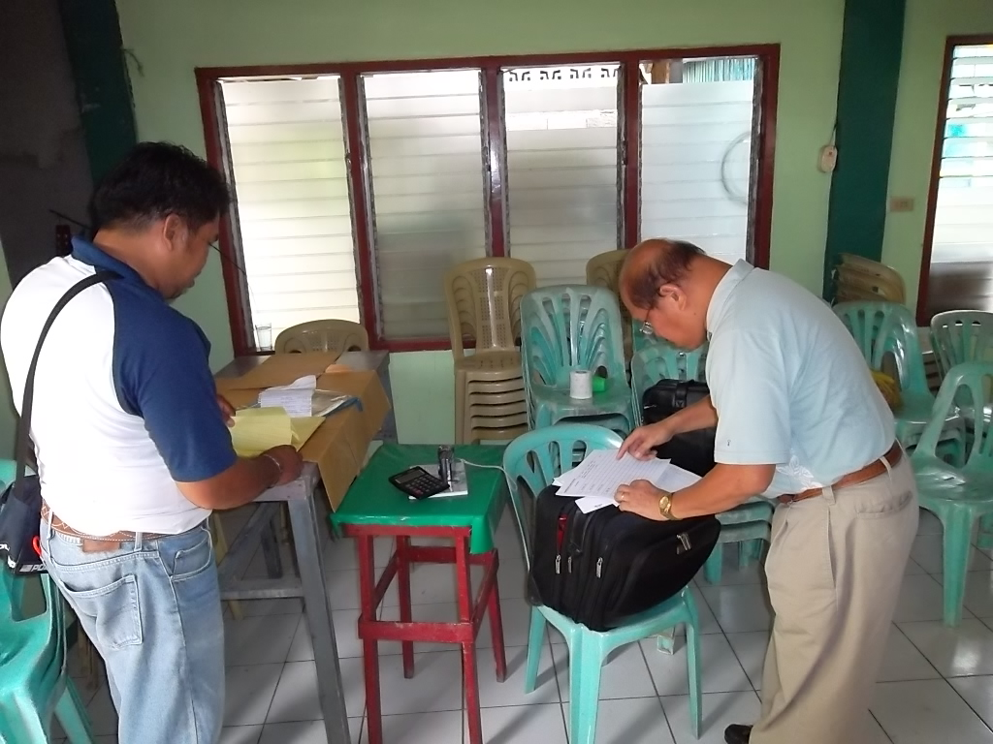
Philippines 2012

Slide 16
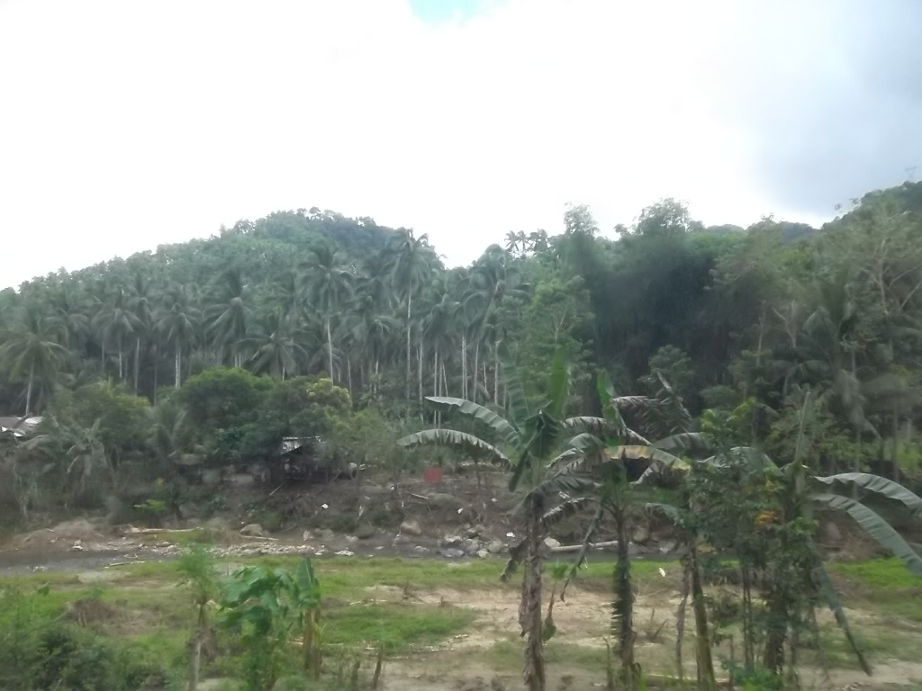
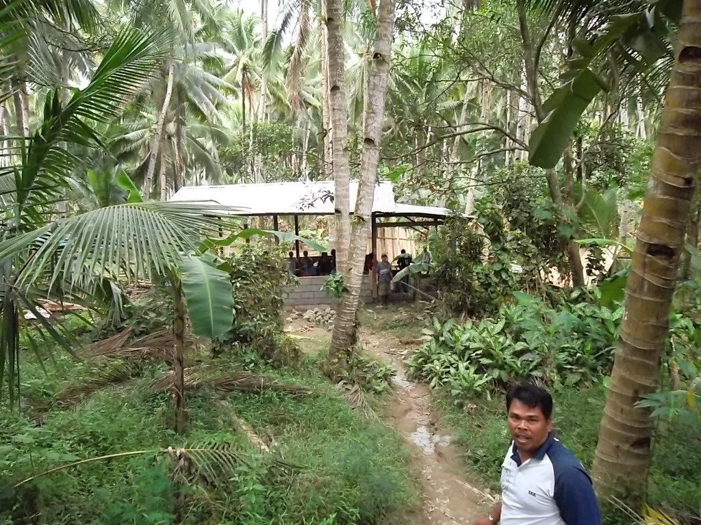
Philippines 2012
Mandulog

Slide 17
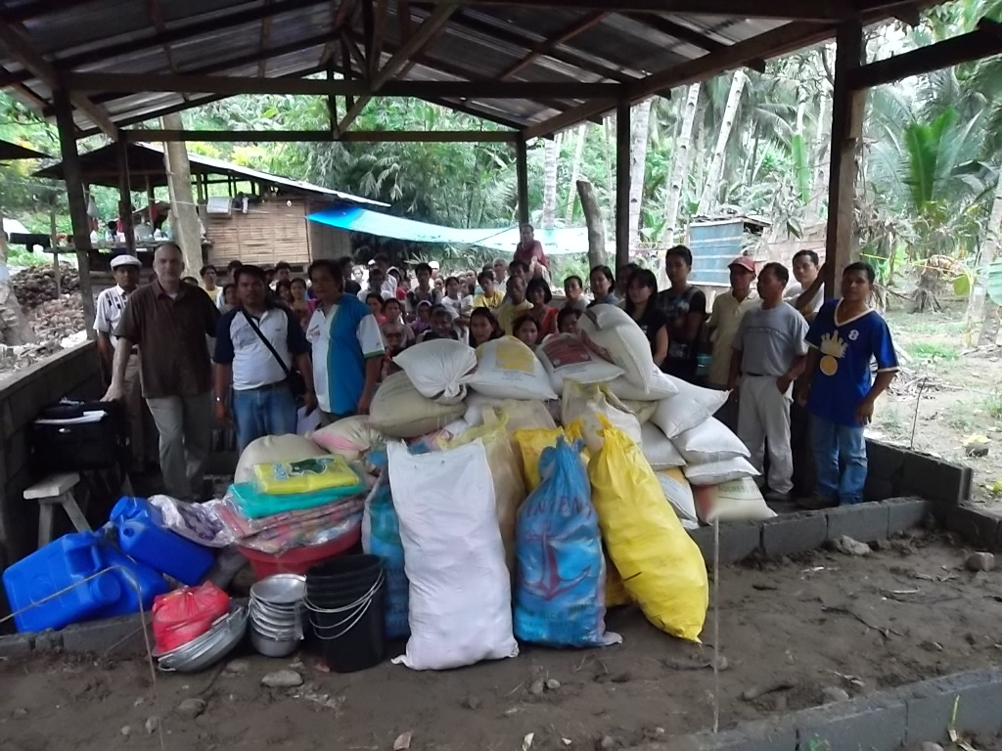
Philippines 2012

Slide 18
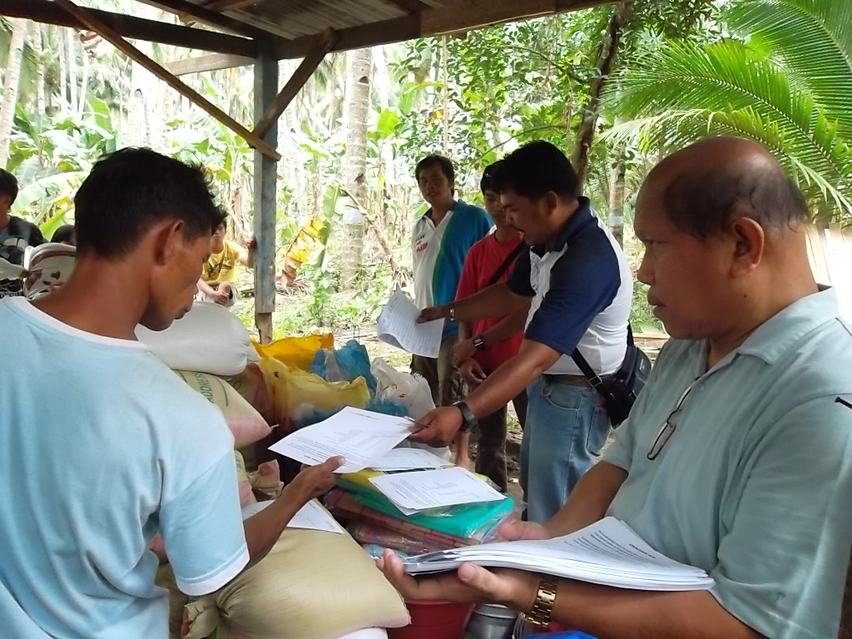
Philippines 2012

Slide 19
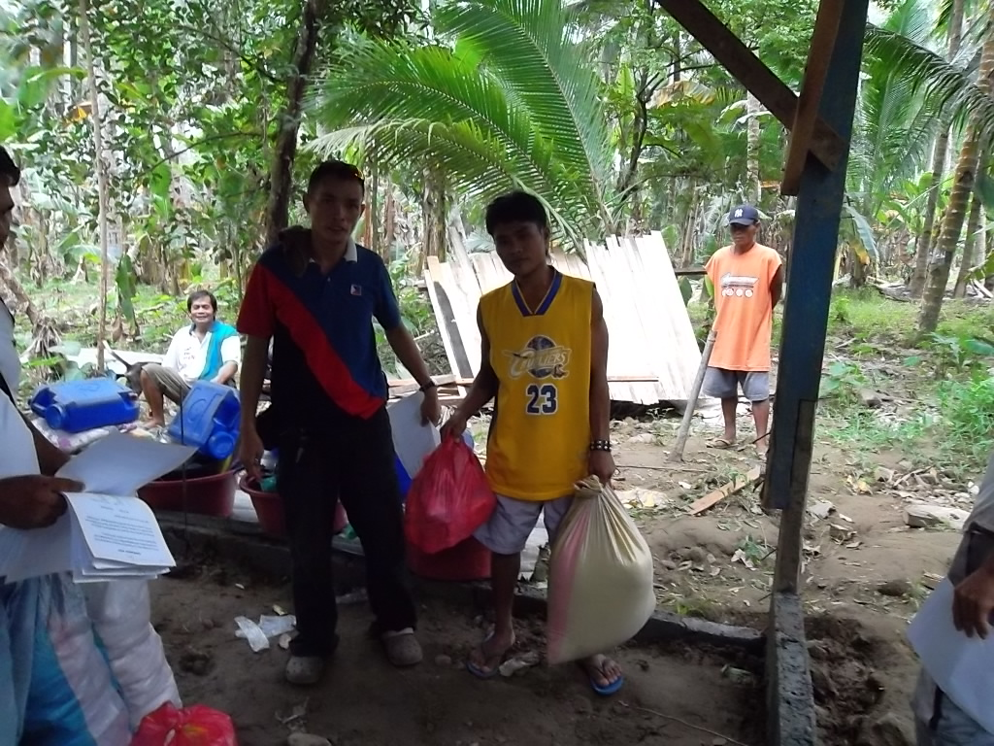
Philippines 2012

Slide 20
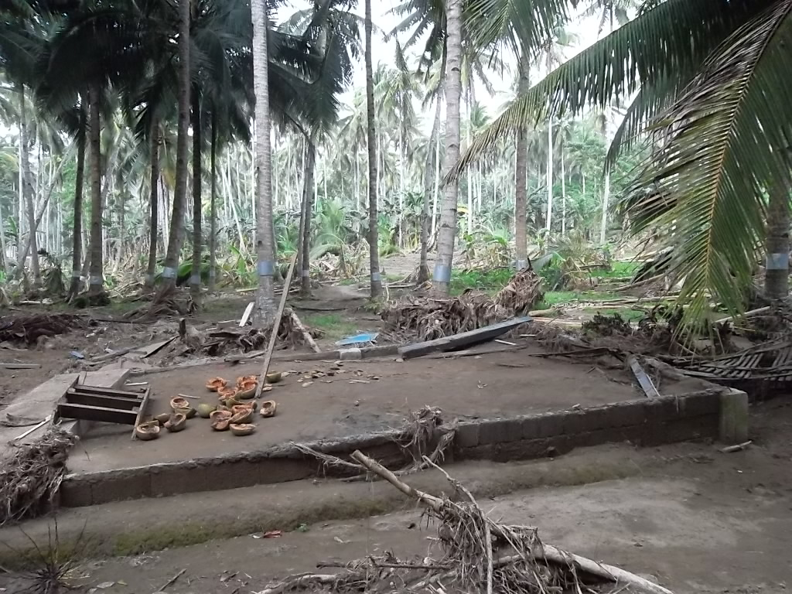
Philippines 2012

Slide 21
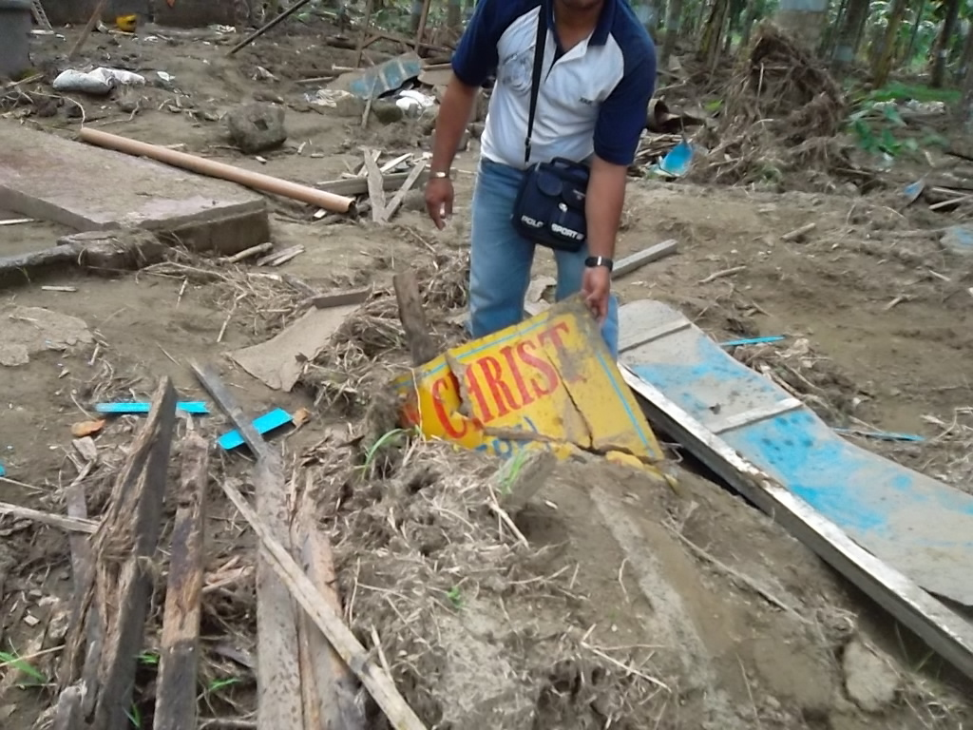
Philippines 2012

Slide 22
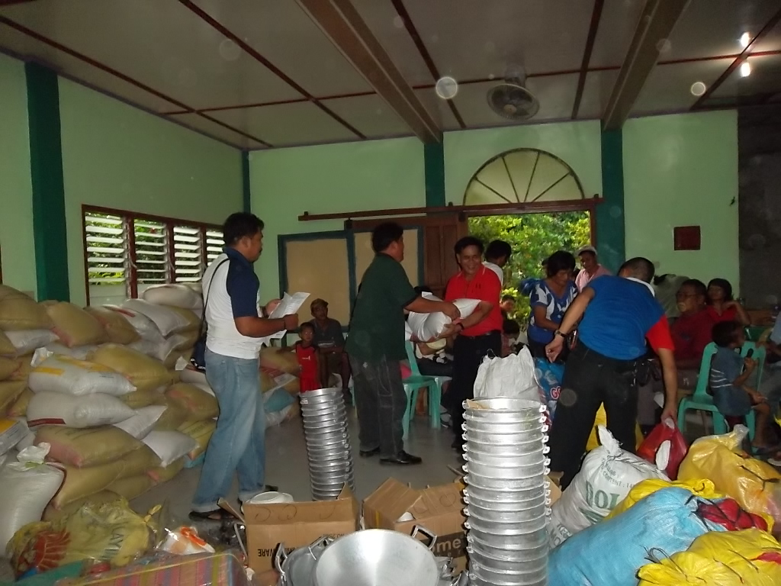
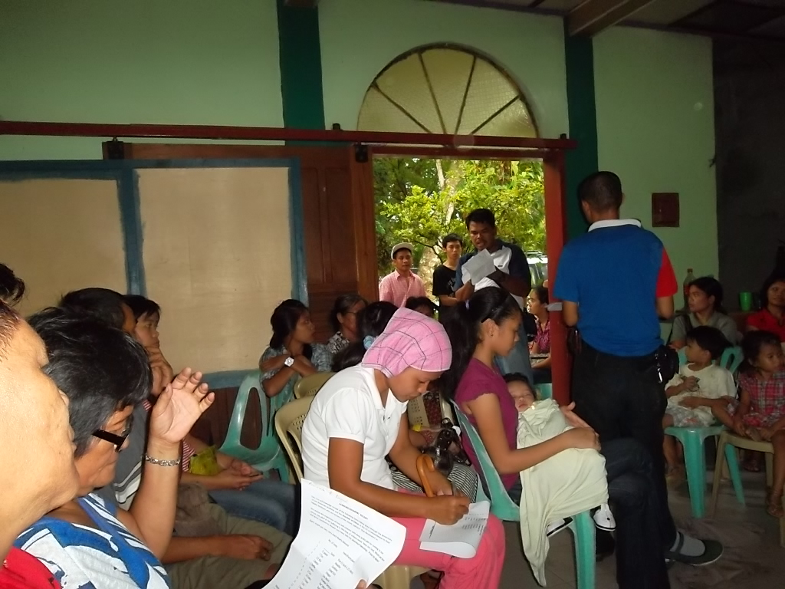
Philippines 2012
Santiago church of Christ – Iligan

Slide 23
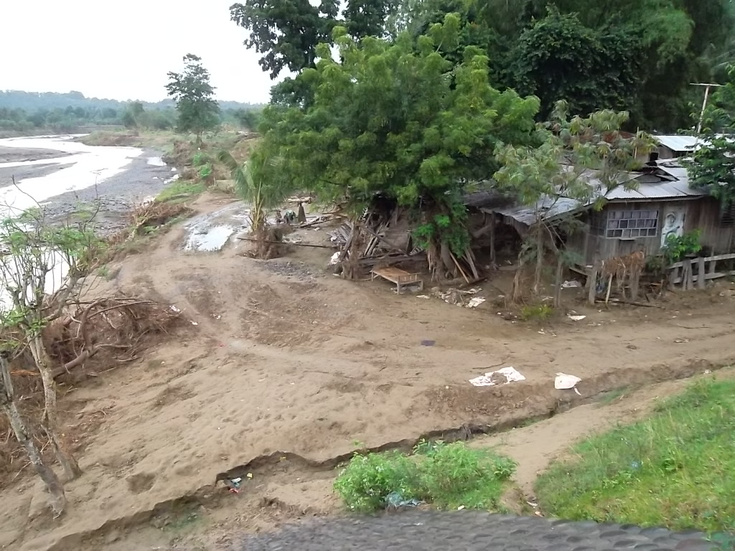
Philippines 2012

Slide 24
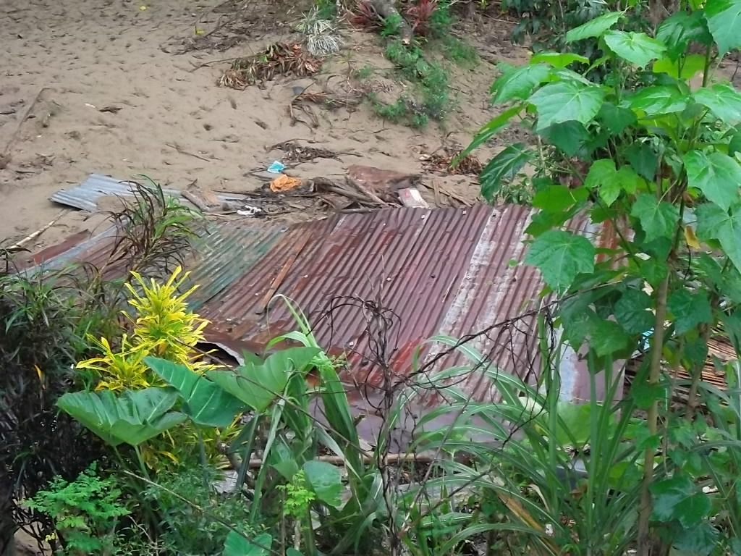
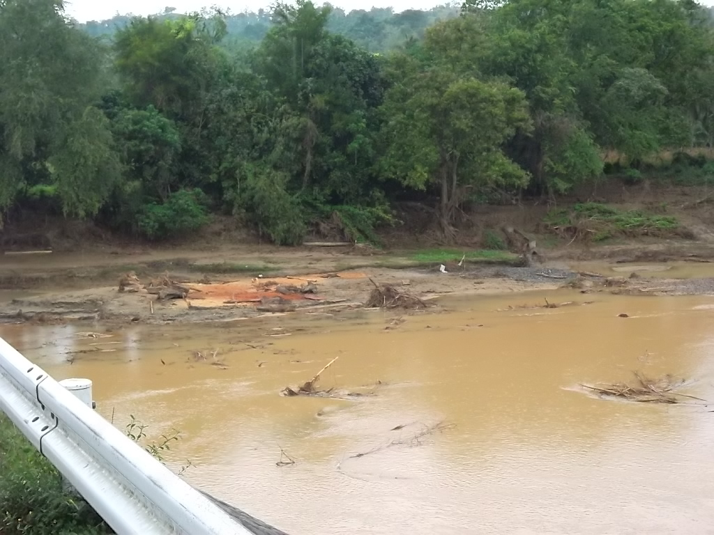
Philippines 2012

Slide 25
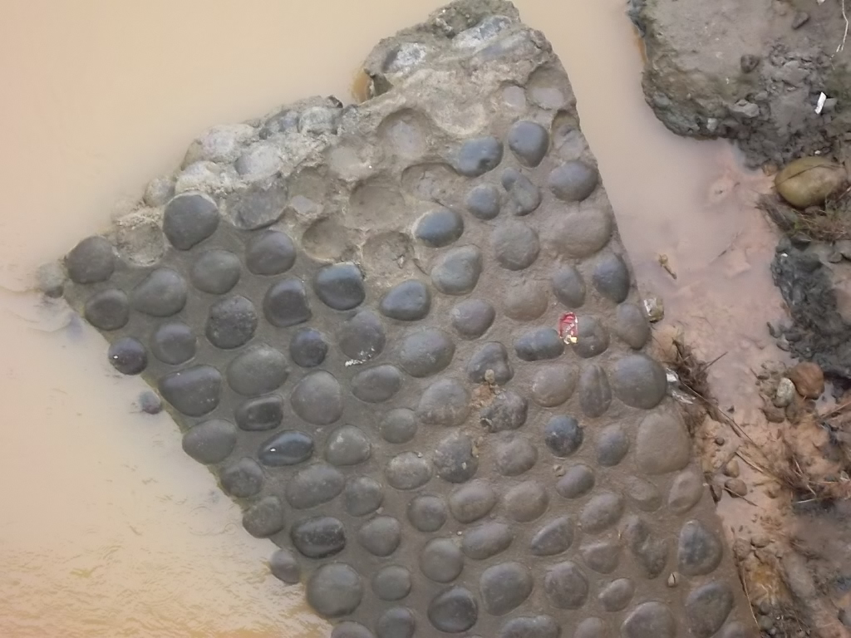
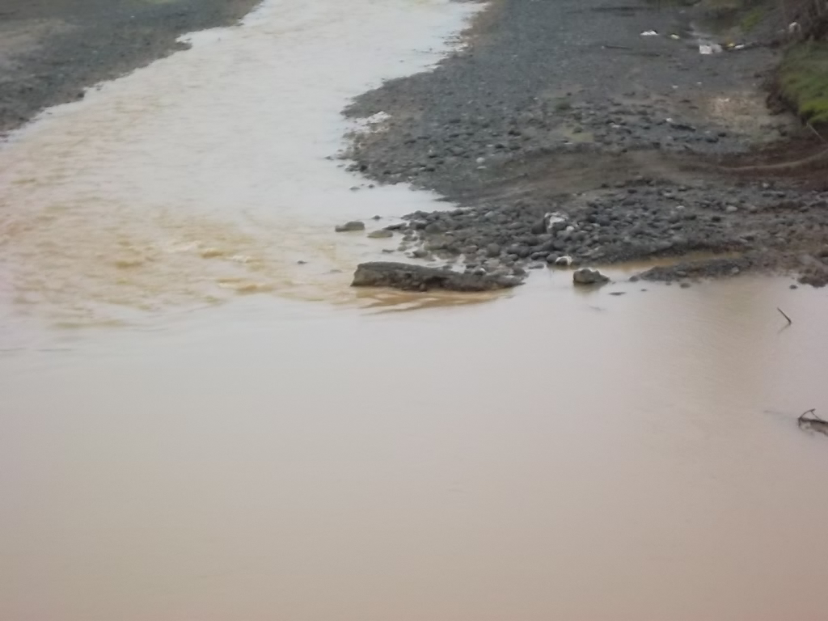
Philippines 2012

Slide 26
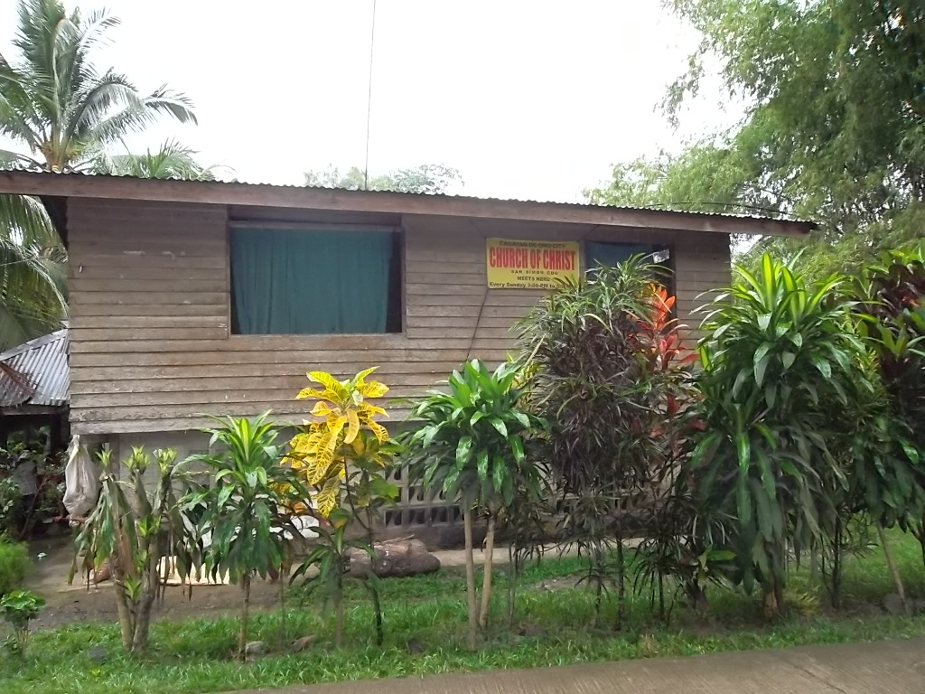
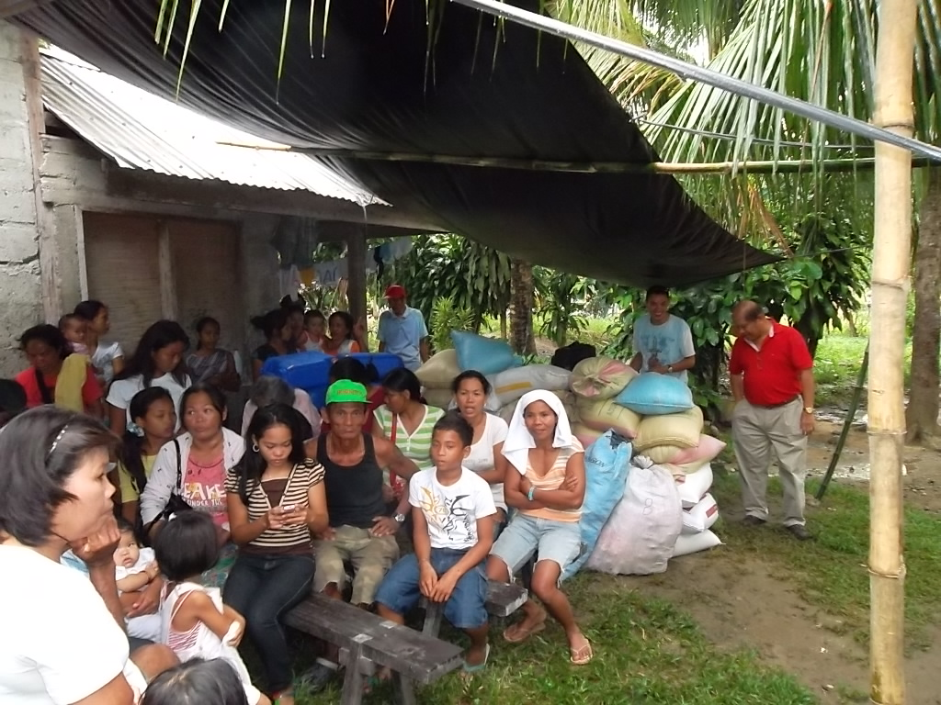
Philippines 2012
San Simon church of Christ

Slide 27
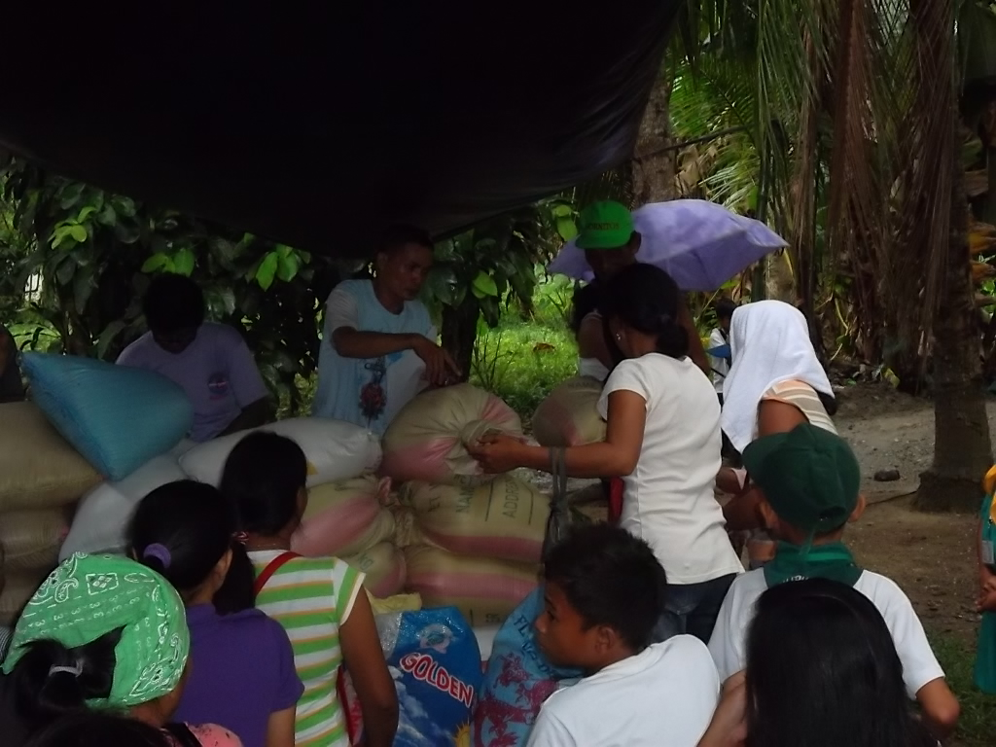
Philippines 2012

Slide 28
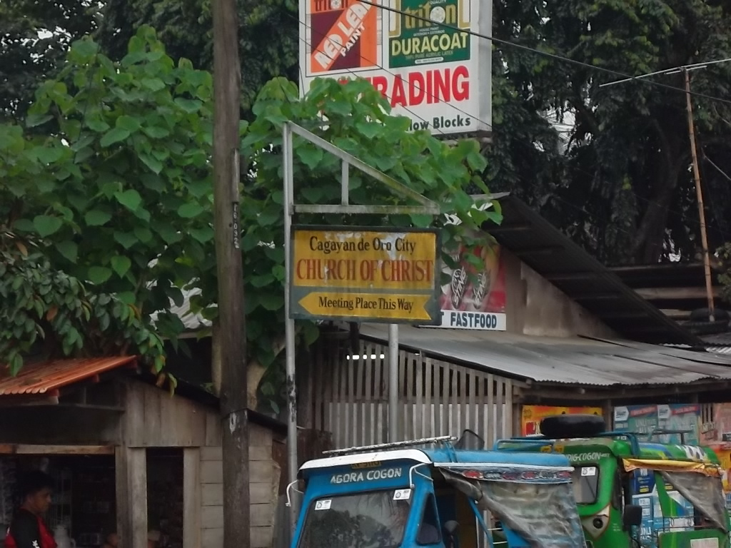
Philippines 2012
Cagayan De Oro church of Christ

Slide 29
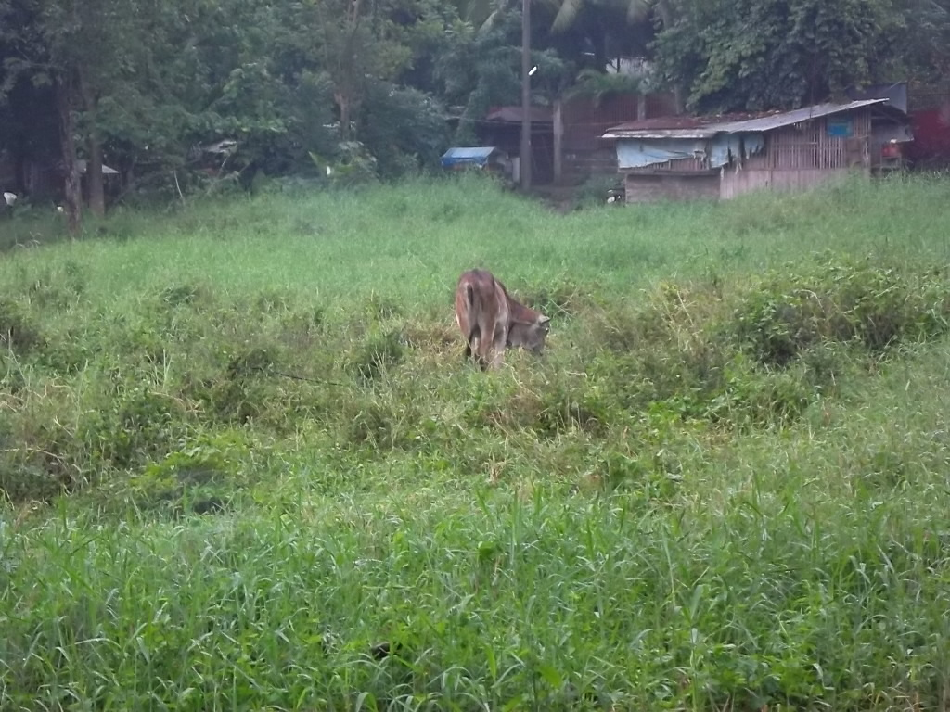
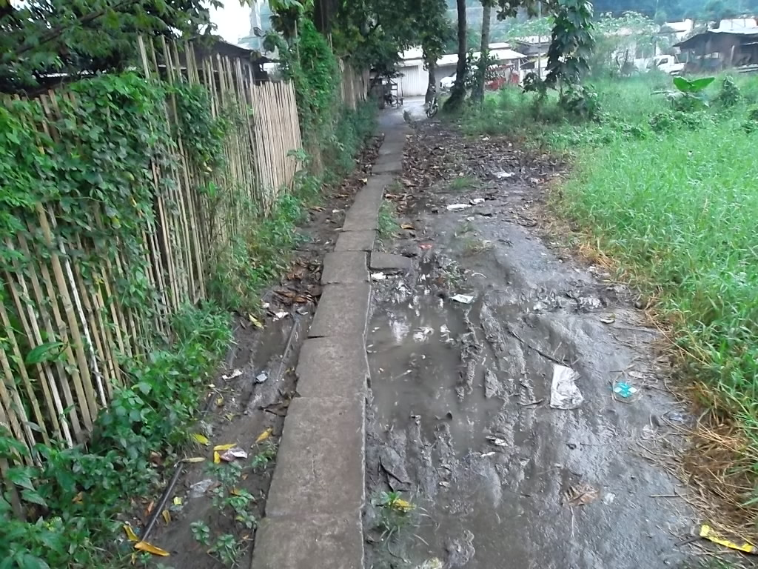
Philippines 2012

Slide 30
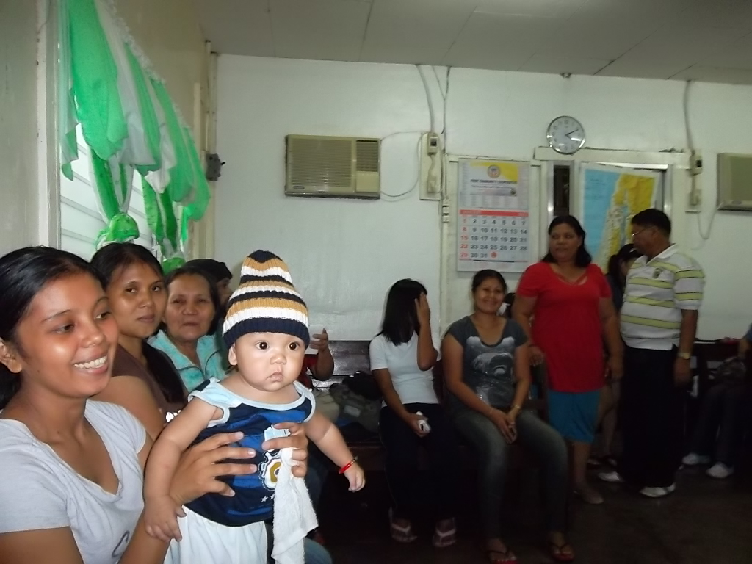
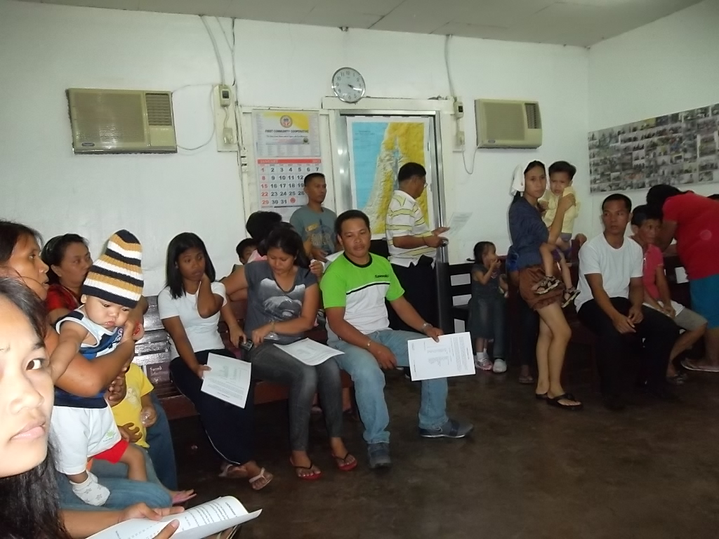
Philippines 2012

Slide 31
Philippines 2012

Slide 32
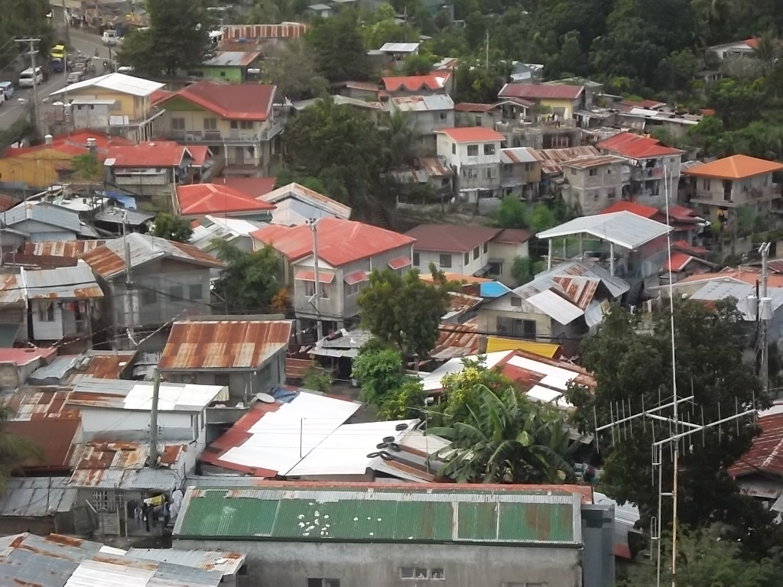
Philippines 2012
Cebu City

Slide 33
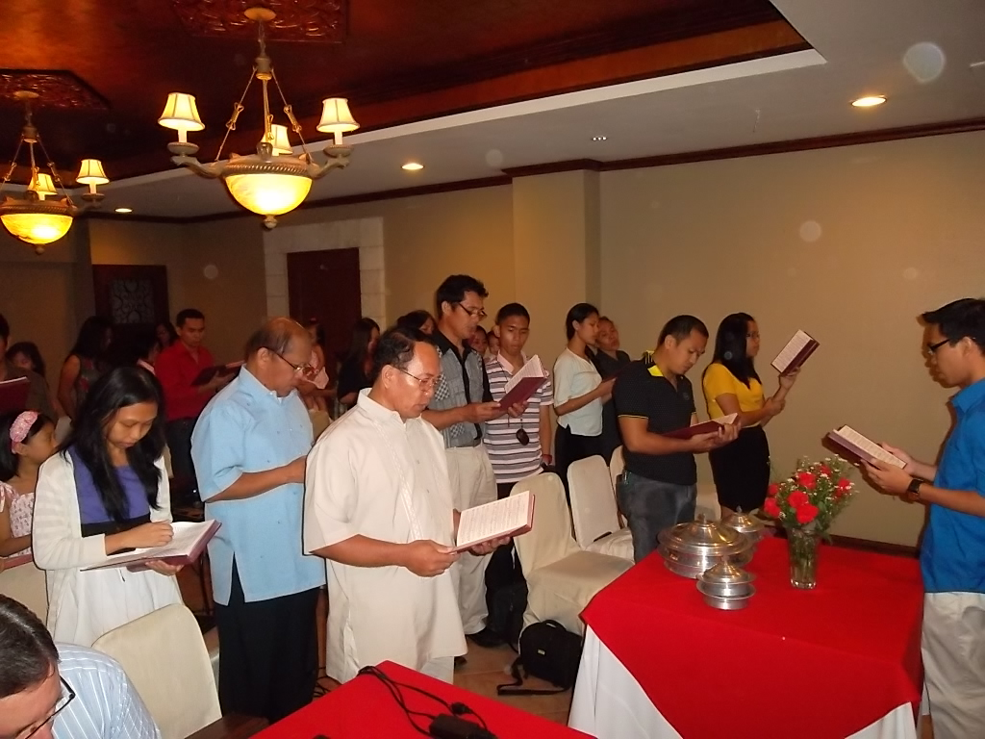
Philippines 2012

Slide 34
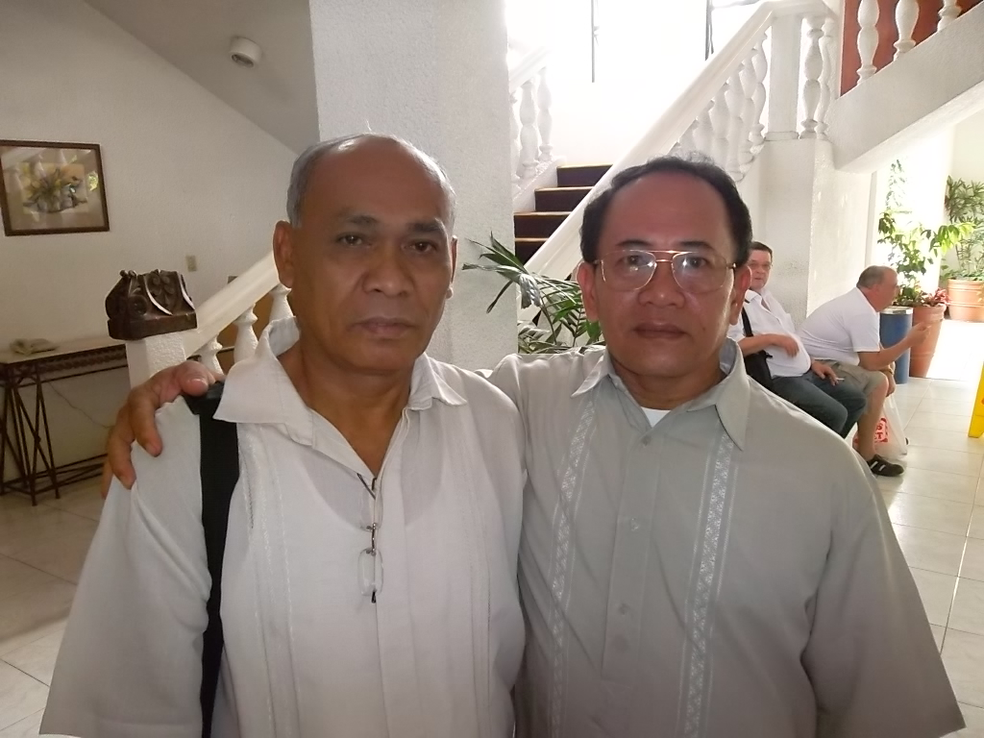
Philippines 2012
Jack Jaco and Fred

Slide 35
Philippines 2012

Slide 36
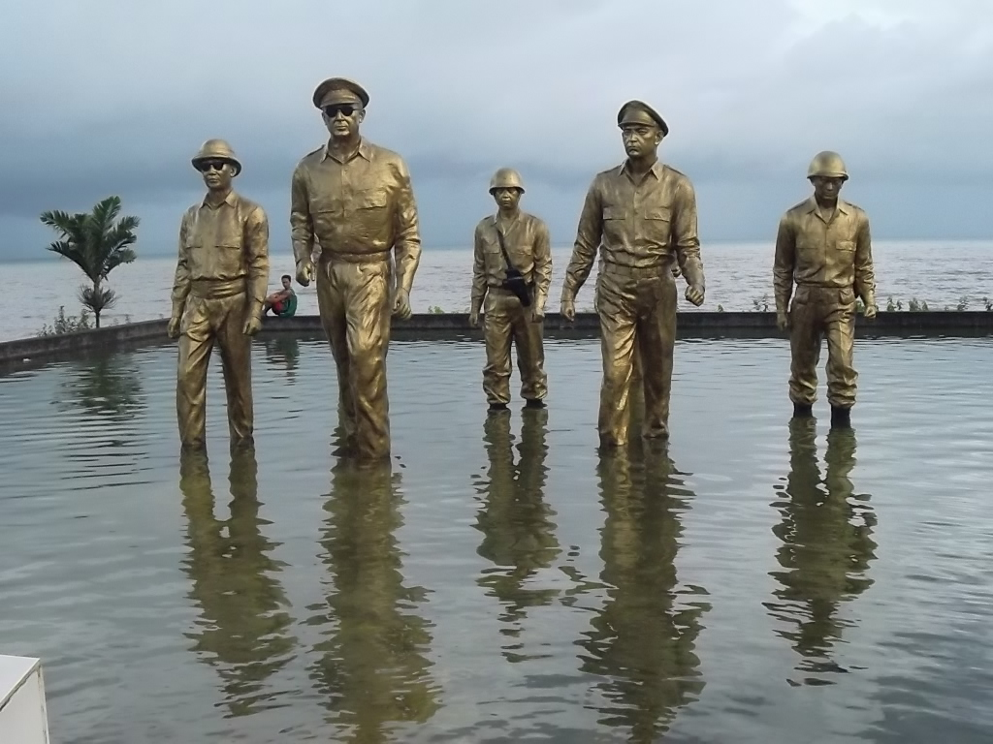
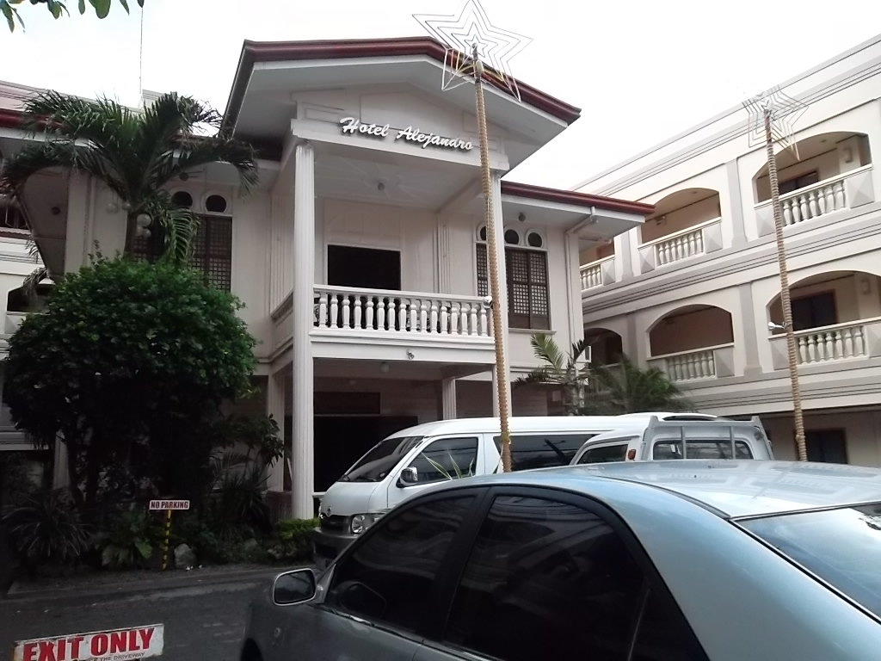
Philippines 2012
Tacloben, Leyte

Slide 37
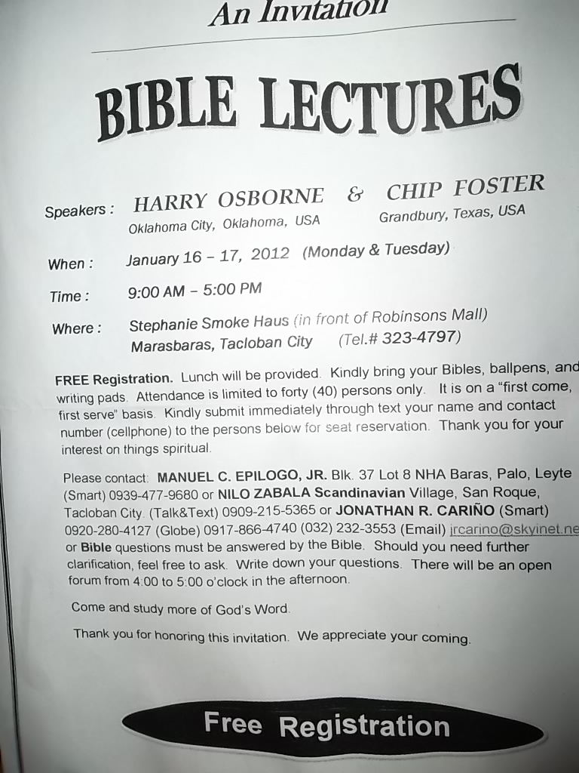
Philippines 2012

Slide 38
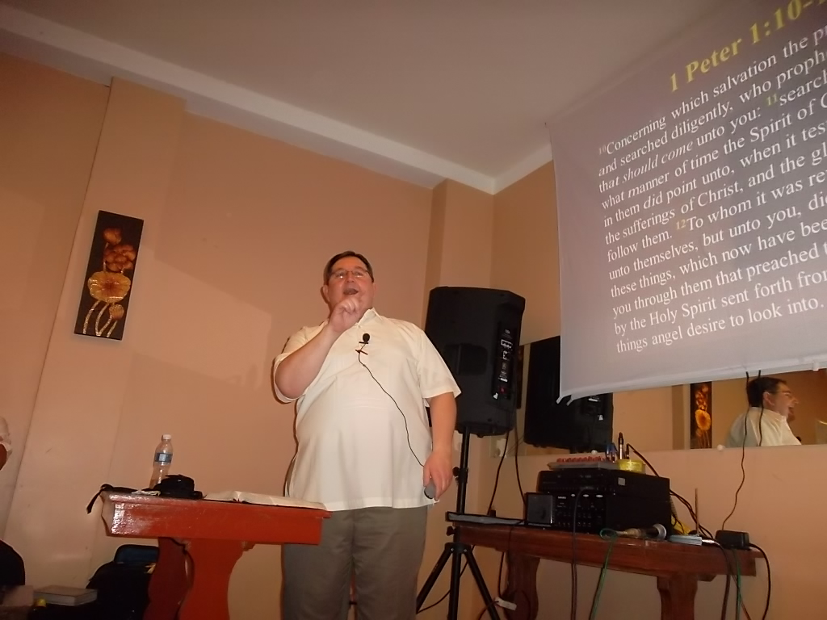
Philippines 2012

Slide 39
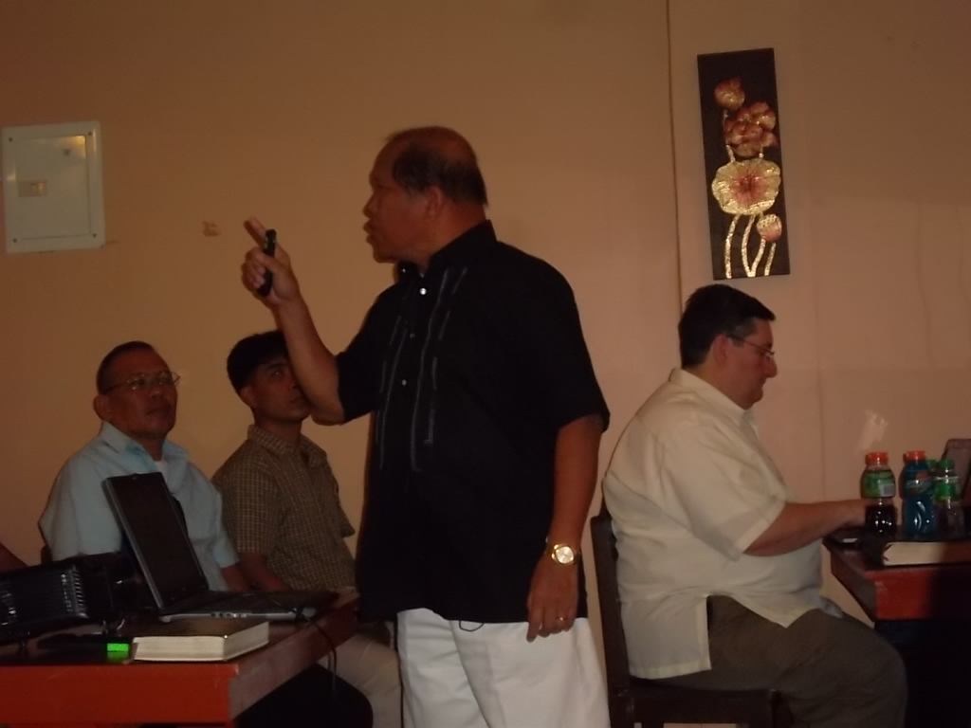
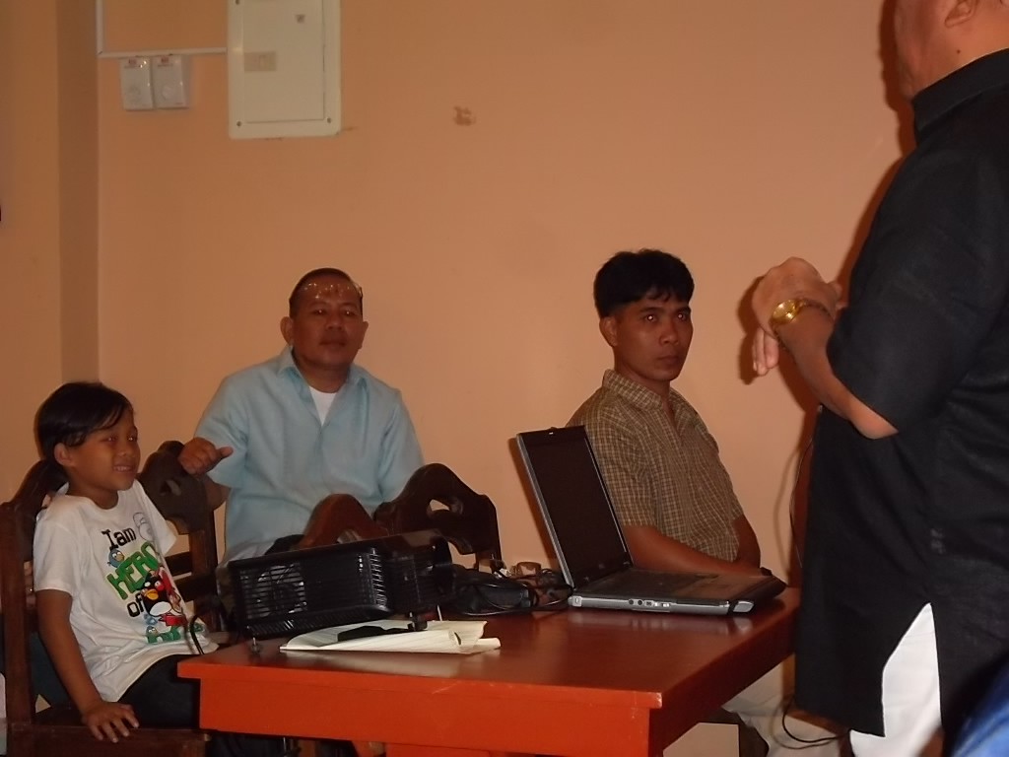
Philippines 2012
Jonathan Carino, Nilo Zabala, Jack Jaco
Manny Epilogo, and Nilo

Slide 40
Philippines 2012
Nine to be baptized at Tacloben

Slide 41
Philippines 2012

Slide 42
Philippines 2012

Slide 43
Philippines 2012
Travel in the Philippines

Slide 44
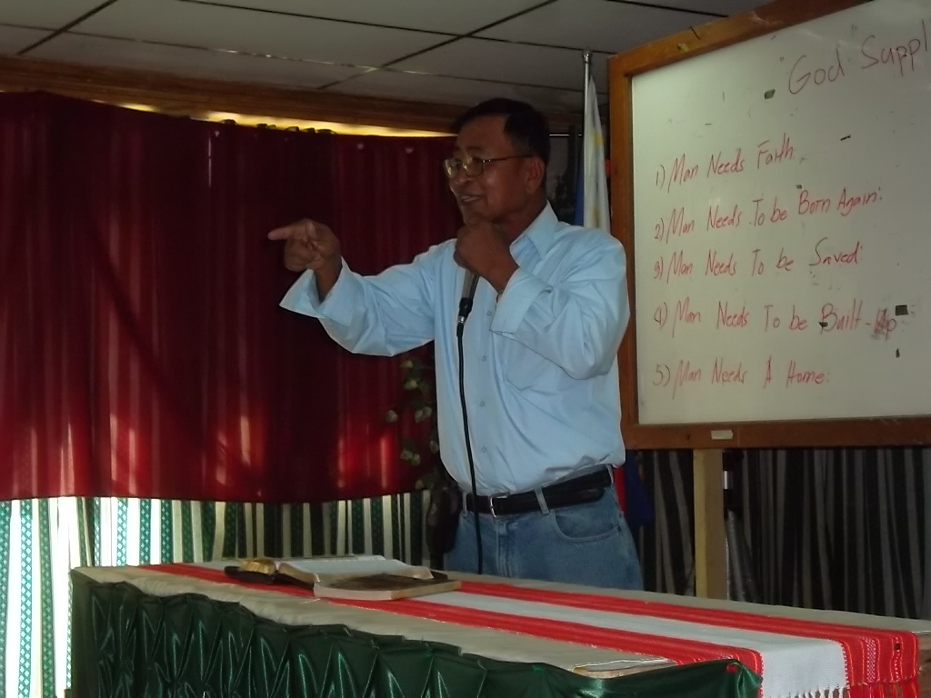
Philippines 2012
Lectures in Tabuk
Ben Vistro

Slide 45
Philippines 2012

Slide 46
Philippines 2012
Four to be baptized in Tabuk
Jhun Gumpad

Slide 47
Philippines 2012
Burayucan church of Christ

Slide 48
Philippines 2012

Slide 49
Philippines 2012
Rody Gumpad

Slide 50
Philippines 2012
Four to be baptized at Burayucan. Two more were baptized when they arrived at the river.

Slide 51
Philippines 2012

Slide 52
Philippines 2012
Centro church of Christ

Slide 53
Philippines 2012
Four to be baptized at Centro.
Kenneth Efraim

Slide 54
Philippines 2012
Metro church of Christ –
Tuguegarao

Slide 55
Philippines 2012
One to be baptized
at Tuguegarao

Slide 56
Philippines 2012
Marcos

Slide 57
Philippines 2012
Escoda church of Christ – Laoag

Slide 58
Philippines 2012

Slide 59
Philippines 2012
Eight to be baptized at Escoda.
Nine were baptized as one more decided on the way.

Slide 60
Philippines 2012

Slide 61
Philippines 2012
Bumitog church of Christ
Our translators, Matt Sibayan Jr. and Gil Caindec

Slide 62
Philippines 2012

Slide 63
Philippines 2012

Slide 64
Philippines 2012
Two to be baptized

Slide 65
Philippines 2012
These “little piggy's” going to market.

Slide 66
Philippines 2012
Nueva Era

Slide 67
Philippines 2012
Sinait church of Christ

Slide 68
Philippines 2012
Mat Sibayan Sr.
One to be baptized

Slide 69
Philippines 2012

Slide 70
Philippines 2012
Nueva Era church of Christ

Slide 71
Philippines 2012

Slide 72
Philippines 2012

Slide 73
Philippines 2012
Pagudpud church of Christ

Slide 74
Philippines 2012
Six to be baptized

Slide 75
Philippines 2012
Ayoyo church of Christ

Slide 76
Philippines 2012
Two to be baptized

Slide 77
Philippines 2012

Slide 78
Philippines 2012

Slide 79
Philippines 2012
Nagsurot Burgos
church of Christ
One to be baptized

Slide 80
Philippines 2012

Slide 81
Philippines 2012
church of Christ Laoag City

Slide 82
Philippines 2012

Slide 83
Philippines 2012
Travel from Laoag to San Fernando by bus.

Slide 84
Philippines 2012
Church of Christ at Caba, La Union

Slide 85
Philippines 2012

Slide 86
Philippines 2012
Denver Domingo

Slide 87
Philippines 2012
Travel to Urdaneta

Slide 88
Philippines 2012
Urdaneta church of Christ

Slide 89
Philippines 2012

Slide 90
Philippines 2012
Travel from Urdaneta
to Manila

Slide 91
Philippines 2012
Kapitbahayan church of Christ

Slide 92
Philippines 2012

Slide 93
Philippines 2012

Slide 94
Philippines 2012
Jerry and Teresa Toreja
Teresa is a doctor. Harry called her for help when he was sick at the beginning of our trip.

Slide 95
Philippines 2012
Our last stop was the prison at Muntinlupa.
We visited with Willie Otey Pastor and his wife Kathy.

